Slide 1
Lab 10 Displaying Web Pages and Maps
By
M.Zakir Khan

Slide 2
I t is interesting to view webpages and Google Maps through Android applications. The Internet and the web pages found there are a huge source of information today. It also is often beneficial to embed a Google Map in an android applications. Map provide an easy way to search destinations. They are widely used in the field of education, hotel business, travel, and tourism.

Slide 3
Displaying Web Pages. Webview is a widget commonly used for viewing web applications or pages. It displays web pages as a part of our activity layout. Let’s make a small browser application that prompts the user to enter the URL of a website and then load and display it through the webview control.

Slide 4
Enabling Javascript
When the webview widget is used for loading web pages,it maintains a history of visited web pages. We can use this web page history to navigate backward and forward.
To view the previous or next page, the goBack() and goForward() method are used.
Note:
In the application we enter URL in the EditText control and press Enter, the application doesn’t insert a blank line in the EditText box, instead it navigates to the entered URL because we have associated a KeyListener with the EditText control

Slide 5
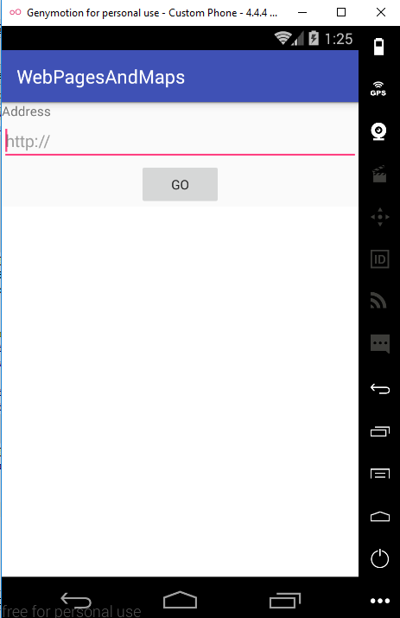
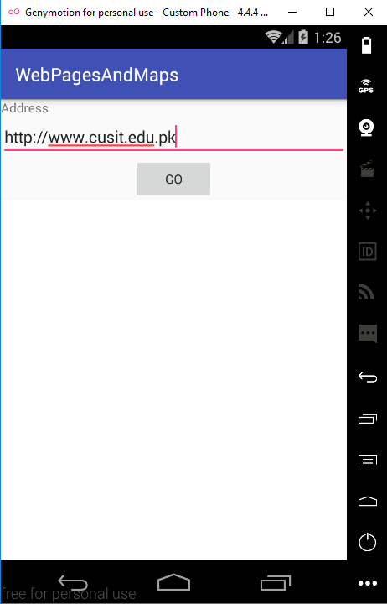
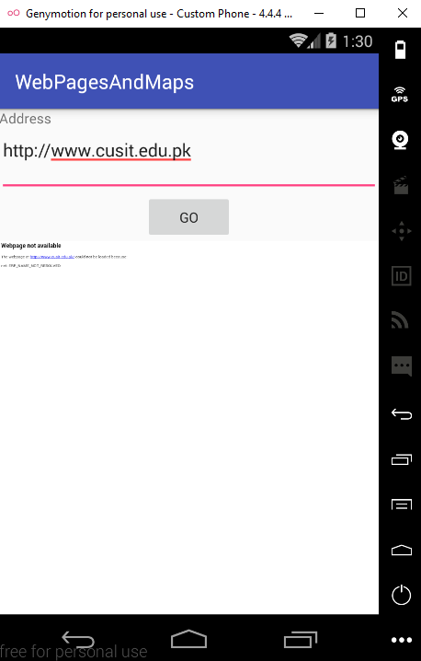
Screen shots without Internet haha

Slide 6
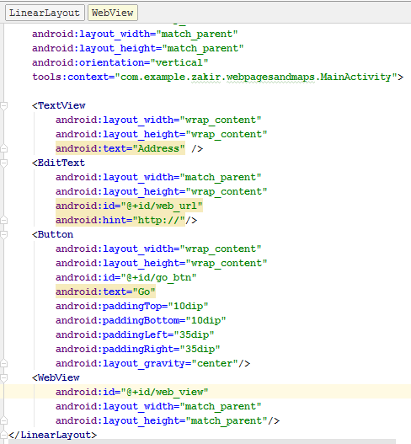
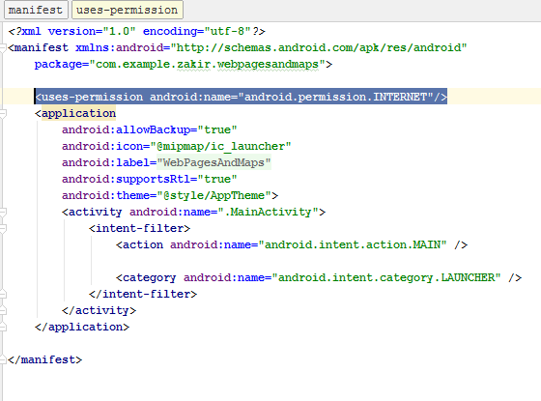
Small changes in Manifest.xml file

Slide 7
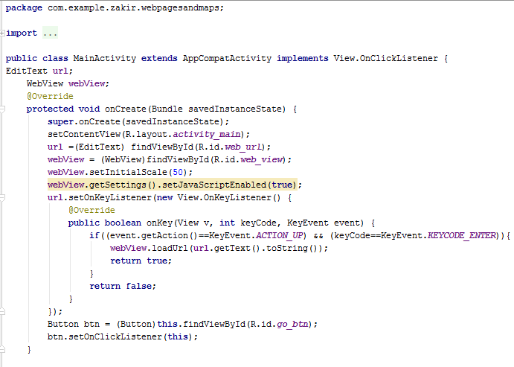
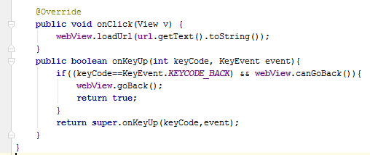
Java code

Slide 8
Using the WebViewClient Class
Android invokes the default Web browser to open and load the linked web page. To open links within our webview, the webViewClient class and its shouldOverrideUrlLoading() method are used.
Use the webViewClient class
Use the shouldOverrideUrlLoading() method to Load the clicked links in the webview control.

Slide 9
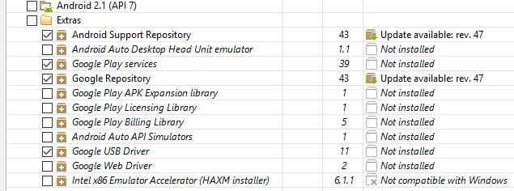
Installing the Google API
For building Google Map-based application, we need to install the Google API. To confirm that it is actually installed select the window, android SDK Manager Option. A dialog box opens showing the status of packages and tools on your machine.
If the google API is not yet installed, you can select it in the Android SDK Manager window and then click the Install package button.

Slide 10
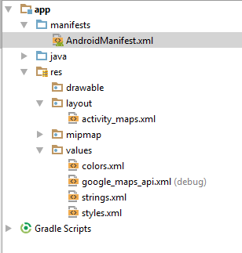
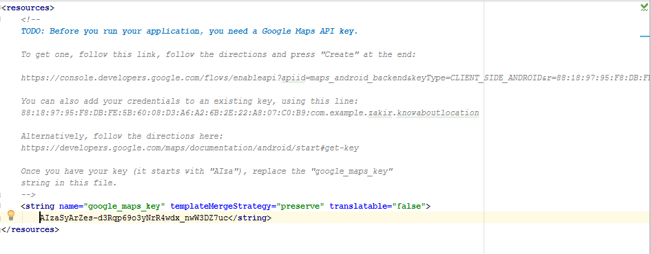
Key Obtaining from Google Developer Console

Slide 11
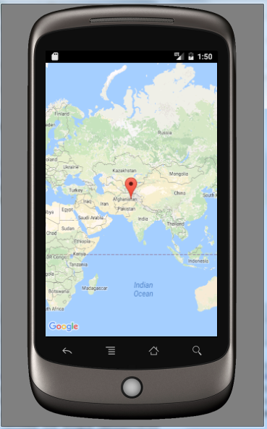
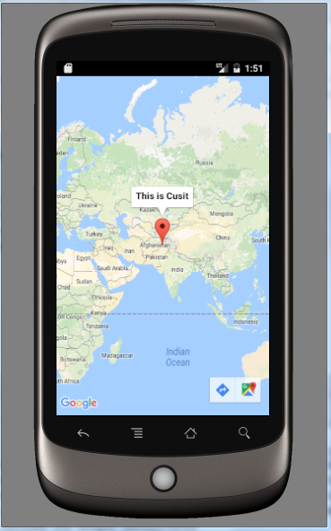
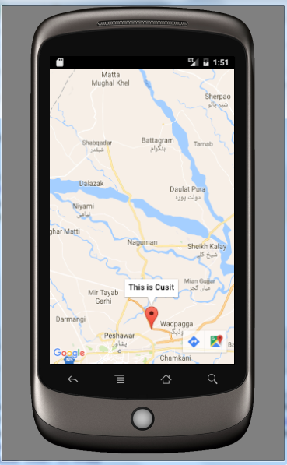
Screen Shots

Slide 12
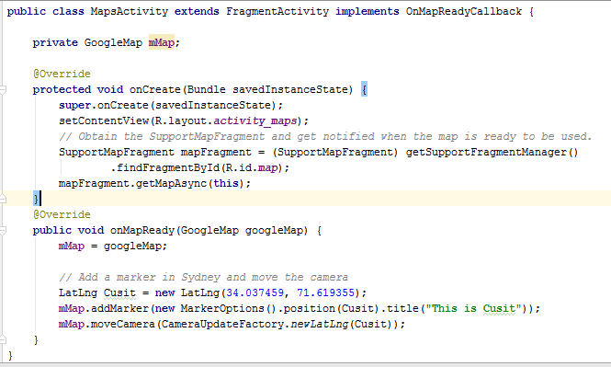
MainActivity.java

Slide 13
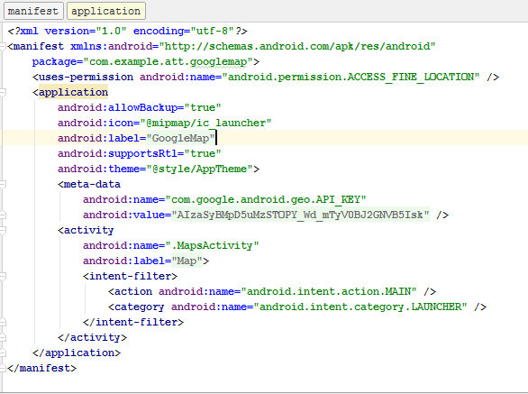
Manifest.xml changes requires

Slide 14
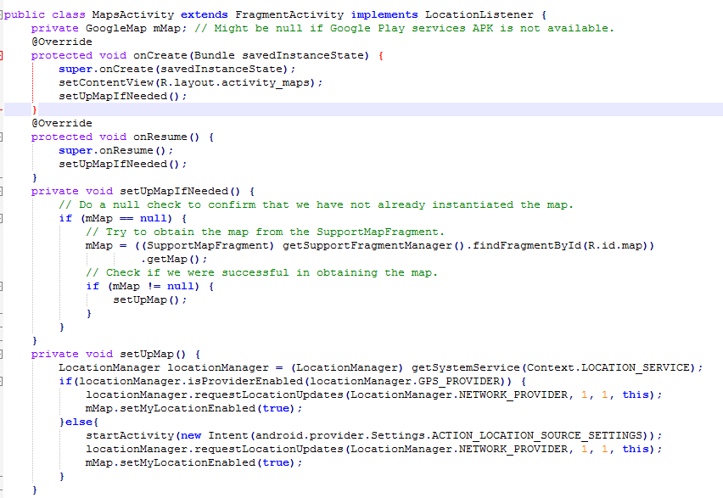
How to get User Location using GoogleMap

Slide 15
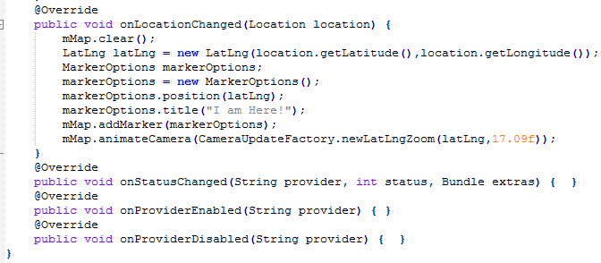
Continue…

Slide 16
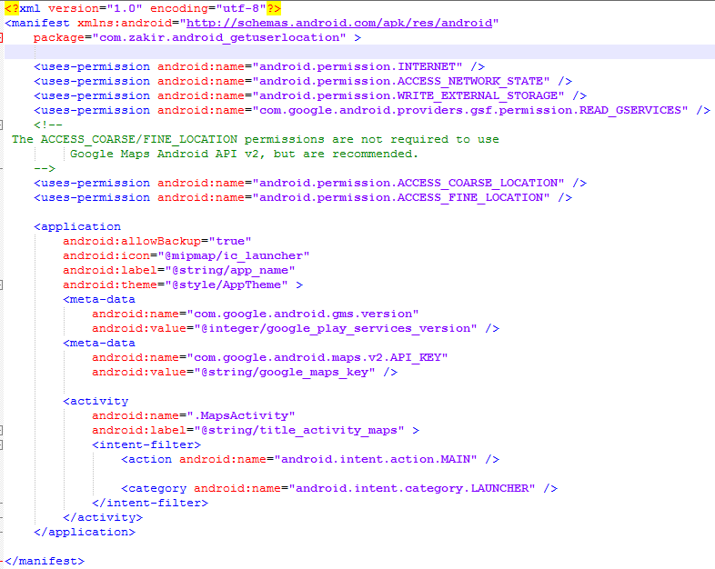
Add changes in Manifest.xml file

Slide 17
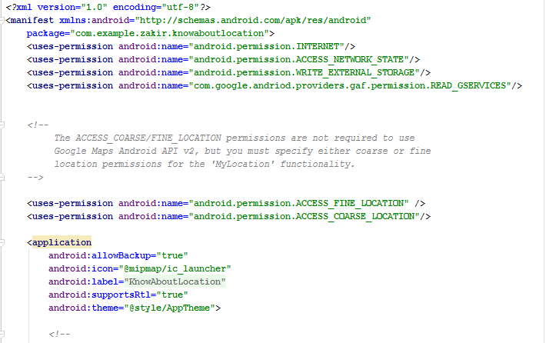
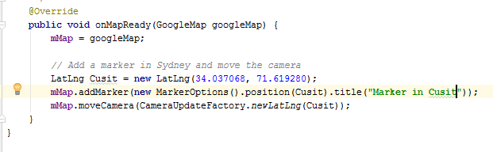
Add permission in Manifest file

Slide 18
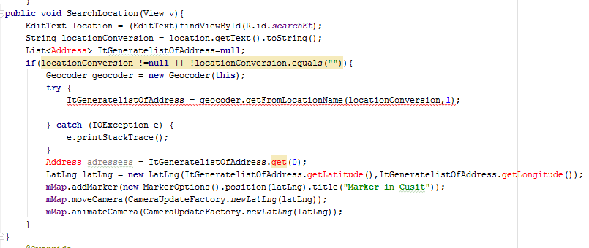
Search the Location

Slide 19
Obtaining Google Maps API key
You need to apply for a free Google Map API key before you can integrate Google Maps into your Android application.
The steps for obtaining a Google key as follow.
To get a Google Key, the application needs to be signed with the certificate and you need to notify Google about the Hash(MD) fingerprint of the certificate. To test the application on the Android emulator, search for the SDK debug certificate located in the default folder C:\Users\<user_name>\.android. The filename of the debug certificate is debug.keystore. For deploying to a real android device, substitude the debug.keystore file with your own keystore file.
Copy the debug.keystore to any drive.

Slide 20
Obtaining Google Maps API key
3. Using the debug keystore certificate, extract its MD5 fingerprint using the keytool.exe application provided with the JDK installation. This fingerprint is needed to apply for the free Google Maps key. The keytool.exe file can be found in the C:\Program Files\Java\jdk_version_number\bin folder.
4. Open the command prompt and go to the C:\Program Files\Java\jdk_version_number\bin folder using the CD command.
5. Issue the following command to exact the MD5 fingerprint:
keytool.exe -list -alias androiddebugkey -keystore "D:\debug.keystore" -storepass android -keypass android

Slide 21
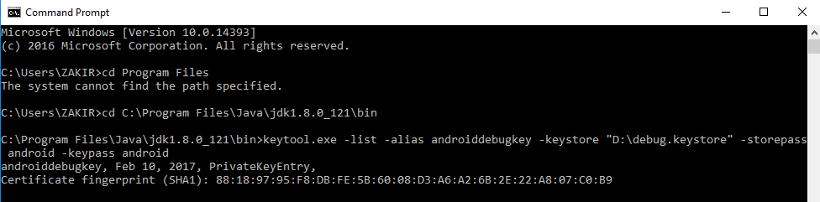
Obtaining Google Maps API key
You get the MD5 fingerprint

Slide 22
Creating a Google Map-Based Application
To access Google Map in Application, we have to add the following two statements to AndroidManifest.xml file:
The first statement asks for permission to access the internet:
<uses-permission android:name=“android.permission.INTERNET” />
The second statement includes the Android map library
<uses-library android:name=“com.google.android.maps”/>
After adding these two line then the Manifest.xml file will look like this

Slide 23
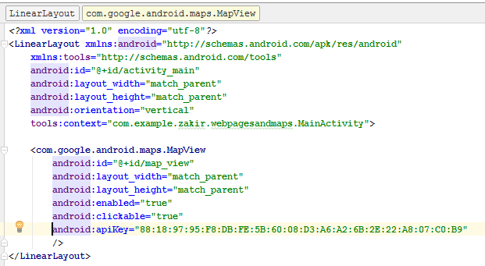
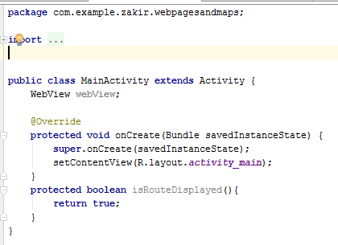
activity.xml +MainActivity.java Code

Slide 24
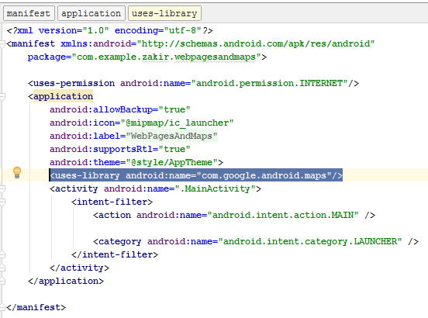
Manifest.xml

Slide 25
Manifest.xml

